Slide 1
Python Bootcamp
Download Anaconda for Python 3.7:
anaconda.com/download

Slide 2

INSTRUCTOR INTRODUCTION
Steve Iannaccone
Business Intelligence at Ibotta
Data Scientist at Gaia
Business Intelligence at Univ. of Colorado

Slide 3
INTRODUCTIONS
Name
Why did you decide to take this bootcamp?
A fun fact about you

Slide 4
LEARNING OBJECTIVES
VISUALIZATIONS TO ANALYZE DATA
In today’s lesson, we will:
Survey introductory Python concepts and syntax.
Discuss the advantages & disadvantages of using Python.
Explain how think about data representation in Python.
Explore approaches to data analysis using popular Python libraries.
Demonstrate how to use different platforms for working with data in python.

Slide 5
OPENING
Excel, Tableau, and other applications are quite powerful. But all applications have limits. Programming allows us to move beyond those limits.
There are many different ways to program - and many different languages.
What can programming languages do?
Analyze (text, numbers)
Retrieve (information from files, web pages, databases)
Send (information through e-mails, databases)
Create/Edit (text files, images)

Slide 6
DATA ANALYSIS WITH PYTHON
INTRODUCTION TO PYTHON

Slide 7











WHO USES PYTHON

Slide 8
WHAT IS PYTHON
Python is an open-source programming language, created in 1991 specifically to be readable and efficient.
Because the code that powers python is free and accessible, an active community of users has grown up to modify and extend it, adding features that expand its functionality and ease of use.
Some of these features are called “libraries” - we’ll return to these in a bit!

Slide 9
HOW IS PYTHON USED
Scripting Language
Automating simple tasks (testing, building, deployment, monitoring)
Acts as “glue” that holds other code together (can interact with C and Java code)
Website Design
Django
Flask
Analysis
Machine Learning
GIS
Interfacing with Databases
Graphics
Interfacing with Maya and Renderman
Visualizing data analysis

Slide 10
PYTHON IS...
Why do so many people like python?
Python is relatively easy to learn, compared to many other programming languages.
Python is a versatile language that can be used in a variety of ways, from analyzing data to programming software.
Python has many great open-source tools that increase efficiency and ease of use, while providing new functionality.
Python tools make it easy to get involved in exciting, cutting-edge machine learning applications, including developments in artificial intelligence.

Slide 11
PYTHON VS THE COMPETITION
In many industries, SAS and R remain the most commonly used tools for data analysis. However, SAS and SPSS are expensive, closed systems, with limited ecosystems and huge barriers to entry.
Meanwhile, Python (and R) is free, open-source, features an active ecosystem of users and tools, with few barriers to entry (other than a desire to learn).
SAS / SPSS:
Expensive licensing
Closed systems
Limited ecosystems
Large barriers to entry for new users
Python / R:
Free
Open systems
Large, active ecosystems
Few barriers to entry for new users
Notes:
Note: Here’s a great summary response about why Python & R are more useful than SAS:
https://www.quora.com/Why-is-SAS-insufficient-for-me-to-become-a-data-scientist-Why-do-I-need-to-learn-Python-or-R

Slide 12
PYTHON VS R
R, developed in 1995 specifically for data analysis, is similar to python in many ways, as mentioned. R is free, has many purpose-built tools that simplify data analysis, and features an active community of users and tutorials. Like R, Python users have created many tools for data analysis. However, Python is generally faster than R, has a simpler learning curve, can be immediately used in production environments, and features packages custom-developed for machine learning and “big data.”
Similarities:
Free
Open systems
Huge ecosystems
Built-in tools & features
Differences:
Speed
Learning curve
Portability / Scalability
Industry trends (ML + “big data”)
Notes:
Emphasize that one is not necessarily “better” than the other, but that they have different use cases.
R was created for analysis in academia and has tons of resources for specific edge cases. Python was built for production code, but users expanded it to include many common data tasks (largely copying R libraries).
Analysts still largely prefer R in many industries; however, python is the language of choice among a select subgroup: data scientists. They prefer python for its speed, portability, big data scalability, and open source libraries.
Currently, python is preferred for ML and big data use cases, but in many other types of analysis, the two languages offer comparable tools and functionality.

Slide 13
DATA ANALYSIS WITH PYTHON
DATA REPRESENTATION USING PYTHON

Slide 14
STRUCTURED VS. UNSTRUCTURED DATA
The two primary types of data are:
1. Structured data
Definition: Structured data are data that are already in an easily queryable format to perform analysis.
Example: data that are already stored in CSV files or accessible with SQL.
2. Unstructured data
Definition: Unstructured data encompasses any type data that isn’t easily queryable; information that isn’t grouped into predefined logical or semantic structures.
Example: The most common form of unstructured data are text fields asking for user feedback.
Notes:
Instructor note: Performing analysis on unstructured text data in text fields requires either a lot of people with standardized scoring or the use of natural language processing (NLP) algorithms that can perform sentiment analysis.
Prompt: Unstructured data is very common. Why might it be difficult to store comments in a structured format? Answer: Many possible reasons!
Think of this use case: Facebook comment data. Users can post comments, but they can also go back and edit them afterward. Therefore, it needs to be decided if we store and access the first version of the comment, the edited version, or all versions.
This can make deciding how to store unstructured data in a standard structured format more difficult (and create much larger files).

Slide 15
PYTHON + EXCEL
Based on this, here are three reasons to consider using Python instead of Excel:
Excel is limited to ~1,048,576 rows by 16,384 columns. Meanwhile, Python can easily handle millions* of rows of data.
Excel’s VLOOKUP function can be slow when dealing with hundreds of thousands of rows. In Python, joining millions of rows takes seconds!
Excel is limited to structured data (rows and columns). Python can easily handle all kinds of data, such as tweets or Facebook comments, in unstructured formats.
Notes:
* Clarification: To put it another way, Python can handle gigabyte-sized data sets, while Excel begins to have problems with tens of megabytes. Depending on your processing power (e.g. if you're running Python on an Amazon EC2 Instance), you could potentially run Python on billions of rows of data.
Instructor prompt:
Ask the class to generate examples for each of these points. (E.g., “Can you think of an example where this would be a problem?”).
Then, explain a Pythonic solution to them.

Slide 16
PYTHON + SQL
SQL vs Python? More like SQL and Python. In practice, most analysts don’t choose one or the other, but instead use a combination of both, depending on their needs.
Similarities:
1. Extracting data from databases
SQL: Runs queries and exports data.
Python: Uses libraries to directly connect to servers and run SQL commands.
2. Performing analytical routines
SQL: GROUP BY, SUM, AVERAGE, MIN, MAX, etc.
Python: Uses library functions to summarize data.
3. Cleaning data
SQL: Changes columns’ data types and alters tables.
Python: Uses library functions to clean data.

Slide 17
PYTHON + SQL
Differences:
1. Processing speed
Processing speeds between Python and SQL can differ dramatically depending on the type of server, your configuration, the data set, and the type of platform being used.
2. Visualizing data
Although some newer SQL systems make it easier to visualize data, SQL is not purely intended for data visualization.
3. Data types
SQL: Can only work with structured data in columns and rows.
Python: Can work with both structured and unstructured data.
Notes:
For example, many Python calculations are usually done locally, which runs off of a computer’s processor. Meanwhile, most SQL commands are done via a terminal system where the processing is completed on a remote server (production-grade Python code is usually run in a similar manner).
While in many cases it may be more efficient to perform a local analysis, if you are compiling code or processing large data sets, it’s almost always better to run on a virtual server.

Slide 18
PYTHON + TABLEAU
Similarities:
1. Can be used to extract data from databases.
Tableau: Can connect to local data or directly to a server.
Python: Uses open-source libraries to directly connect to servers or import local data.
2. Perform analytical routines.
Tableau: Summarizes data, similar to an Excel PivotTable.
Python: Uses built-in functions and open source libraries to summarize data.
3. Visualizing data.
Tableau: Creates interactive dashboards.
Python: Uses open-source libraries to create interactive visualizations.
4. Cleaning data.
Tableau: Can change data types or perform simple text manipulation.
Python: Uses open-source libraries to clean and manipulate data.

Slide 19
PYTHON + TABLEAU
Differences:
1. Ease of use/prior knowledge.
Tableau and python require different skill sets to perform similar tasks, with differing levels of complexity depending on the data and desired output.
2. Visualizing data.
Tableau can create compelling graphs, but you are restricted to its environment.
Python has multiple plotting libraries and can push outputs into production environments.
3. Processing speed.
Tableau can become quite slow when analyzing many millions of rows.
Notes:
Note: Tableau recently announced Tableau Hyper to improve performance.
Likewise, Python is normally limited to the power of your computer, unless you are running it in an online environment.

Slide 20
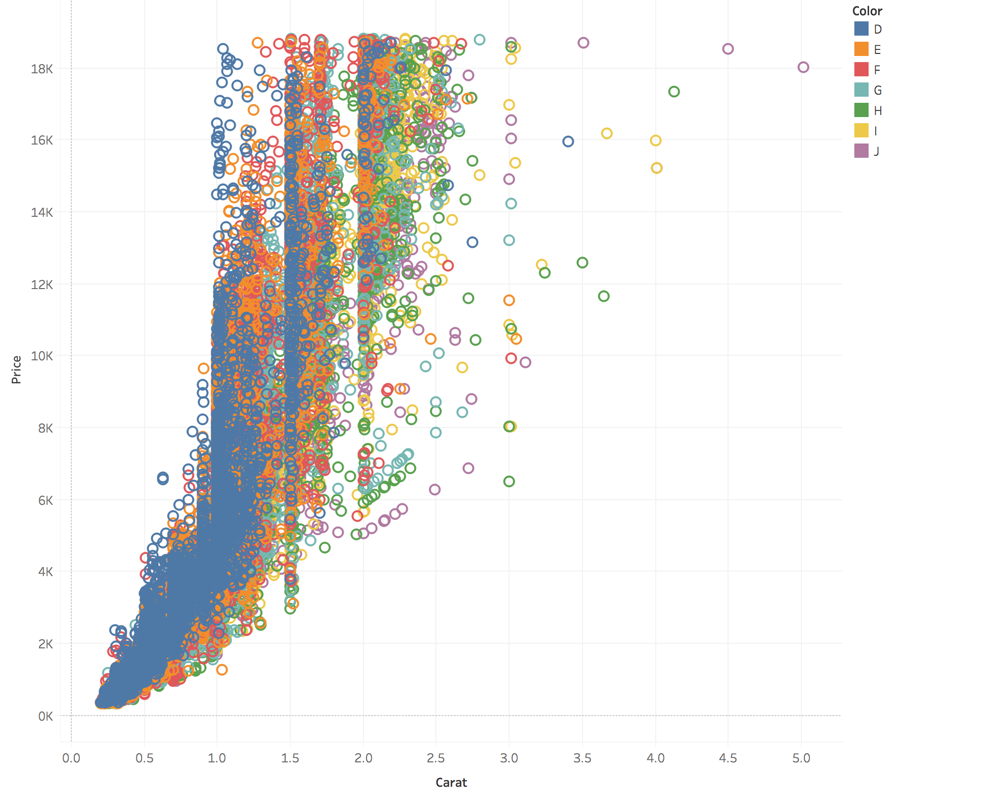
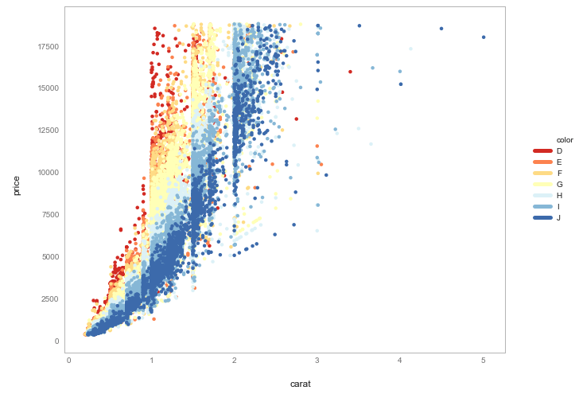
PYTHON + TABLEAU
Diamonds data, plotted with Tableau.
Diamonds data, plotted with Python.
Notes:
Instructor comments: This image is a scatterplot made from the “Diamonds data set” that compares carat and price by color. The image on the left was created using Tableau and the image on the right was created using Python.
Talking Points: There are pros and cons of both platforms (Tableau and Python). Creating graphs with Tableau is as simple as drag and drop, but as we can see with the Python plot, almost anything Tableau can do can also be replicated (for free) using plotting tools in Python. Open-source Python libraries may also allow you to code plots that might not be possible in tools like Tableau and Excel. Large companies may not mind spending money for unified Tableau licenses, but smaller companies might prefer to rely on open-source software (like Python) to keep costs low.
Ultimately, it comes down to your preference, goals, and business constraints.

Slide 21
DATA ANALYSIS WITH PYTHON
COMMON PYTHON TOOLS

Slide 22
WHAT ARE PYTHON LIBRARIES?
You can think of a library as a collection of functions that allow the end user to write code more easily.
When we import a library, we only need to know the code for that specific library and not the underlying code — which can be hundreds of lines!
For example, a function like mean() is actually:
summing all of the numbers in a vector, and then
dividing by the count of the total numbers in the vector.

Slide 23
COMMONLY USED PYTHON LIBRARIES
Data analysis
Pandas: Data analysis tools.
NumPy: Array processing tool.
Arrow: Date/time formatting.
BeautifulSoup: HTML parsing.
Scrapy: Web scraping.
Machine learning
Scikit-learn: Machine learning.
Theano: Multidimensional modeling.
Gensim: Topic modeling & language processing.
TensorFlow: Neural networks.
Keras: Deep learning.
Visualizations
Matplotlib: Plotting visualizer.
Seaborn: Statistical data visualizer.
Bokeh: Interactive visualizations.
Plotly: Interactive graphs.
ggplot: Popular “R” library for Python.
SQL
SQLite: Simple, stand-alone SQL editor.
SQLAlchemy: SQL databases in Python.

Slide 24
WHAT IS PANDAS GOOD FOR?
Pandas is an open-source, BSD-licensed library providing high performance, easy-to-use data structures, and data analysis tools for Python.
Pandas comes in handy when dealing with:
Missing data: Pandas makes it easy to handle missing data (which is represented as NaN).
Size mutability: Columns can be inserted and deleted from the DataFrame and higher dimensional objects.
Data transformation: Pandas offers flexible GROUP BY functionality that allow you to perform split-apply-combine operations on data sets for aggregating and transforming your data.

Slide 25
MORE FUN WITH PANDAS
Here are some other reasons Pandas is one of the most popular libraries for data analysis:
Fancy label-based slicing, indexing, and subsetting of large data sets.
Intuitive merging and joining of data sets.
Flexible reshaping and pivoting of data sets.
Hierarchical labeling of axes (for instance, adding multiple labels per tick).
Robust IO tools for loading data from flat files (CSV and delimited), Excel files, databases. Also allows saving/loading data from the ultrafast HDF5 format.
Time series data: Date range generation and frequency conversion, moving window statistics, moving window linear regressions, date shifting and lagging, and more.

Slide 26
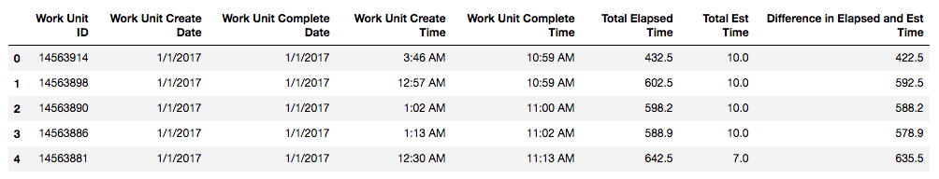
WORKING WITH DATAFRAMES
One of the primary reasons Pandas is so popular is that it makes it easier for analysts to work with dataframes.
A dataframe is a two-dimensional labeled data structure with columns of potentially different types, like this:
Notes:
* Most Python dataframes are single-server, so their size is limited to your computer’s memory…. but they don’t have to be! For example, many data scientists host their data and run their analysis on virtual servers.

Slide 27
WORKING WITH DATAFRAMES
Dataframes are generally represented in a "tabular" format:
Rows: A data structure representing cases.
Columns: Observations or measurements.
In other words, you can think of a dataframe like any other spreadsheet, SQL table, or a dictionary of series objects.
Working in dataframes simplifies the process of analyzing your data.

Slide 28
WHAT CAN YOU DO WITH DATAFRAMES?
So how would you use dataframes in your day to day workflow? You might use them to:
Clean your data.
Calculate summary statistics.
Visually represent your data using plotting libraries.
Use machine learning libraries to make predictions about your data.
Notes:
Examples for each step:
Clean your data
Replace missing values.
Create new columns/variables.
Join multiple tables together to create a master table.
Find summary statistics
Similar to the way you might use GROUP BY or SUM functions in SQL.
Visually represent your data using plotting libraries
Much like you would in Tableau!
Histograms
Line charts
Bar charts
Use machine learning libraries to make predictions about your data.
This is a fast growing area and is one reason python is so popular in data science.

Slide 29
DATA ANALYSIS WITH PYTHON
USING PYTHON

Slide 30
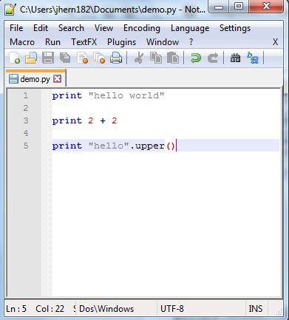
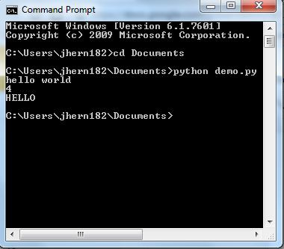
USING PYTHON - SIMPLEST METHOD

Slide 31
USING PYTHON - ADVANCED METHODS
There are other ways of running Python code
We might want to type/run code line-by-line and get an instant result
Use Ipython
We might want to run the code in the same window as our text editor
Use Spyder
We might want to display the results below specific segments of the code
Use Jupyter

Slide 32
PYTHON GRAPHICAL INTERFACES
Included in Anaconda are three commonly used graphical interfaces with Python
IPython: For executing Python commands line by line and interacting with the results
Spyder: For creating larger scripts and executing them in the same window
Jupyter: For displaying code with its results, all in the same document

Slide 33
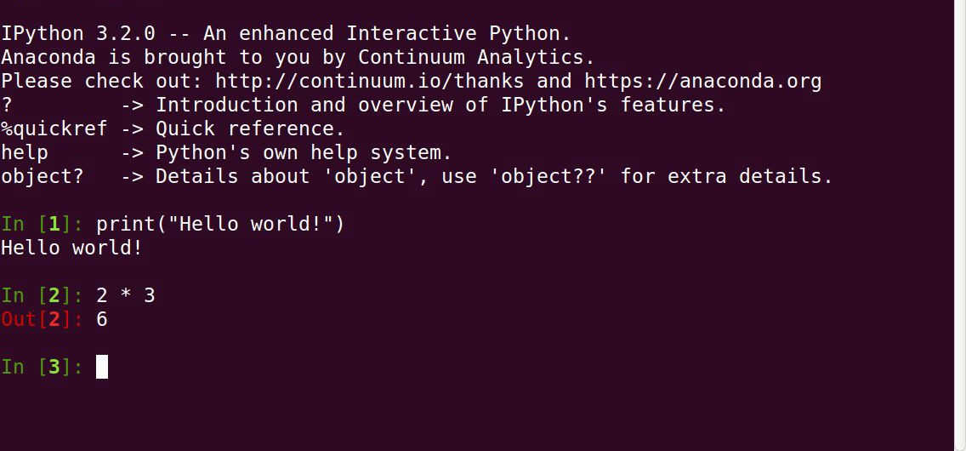
IPYTHON
IPython lets you run short segments of code and instantly see their the results
IPython is ideal when you have a simple task, want to debug, or want to learn Python’s commands

Slide 34
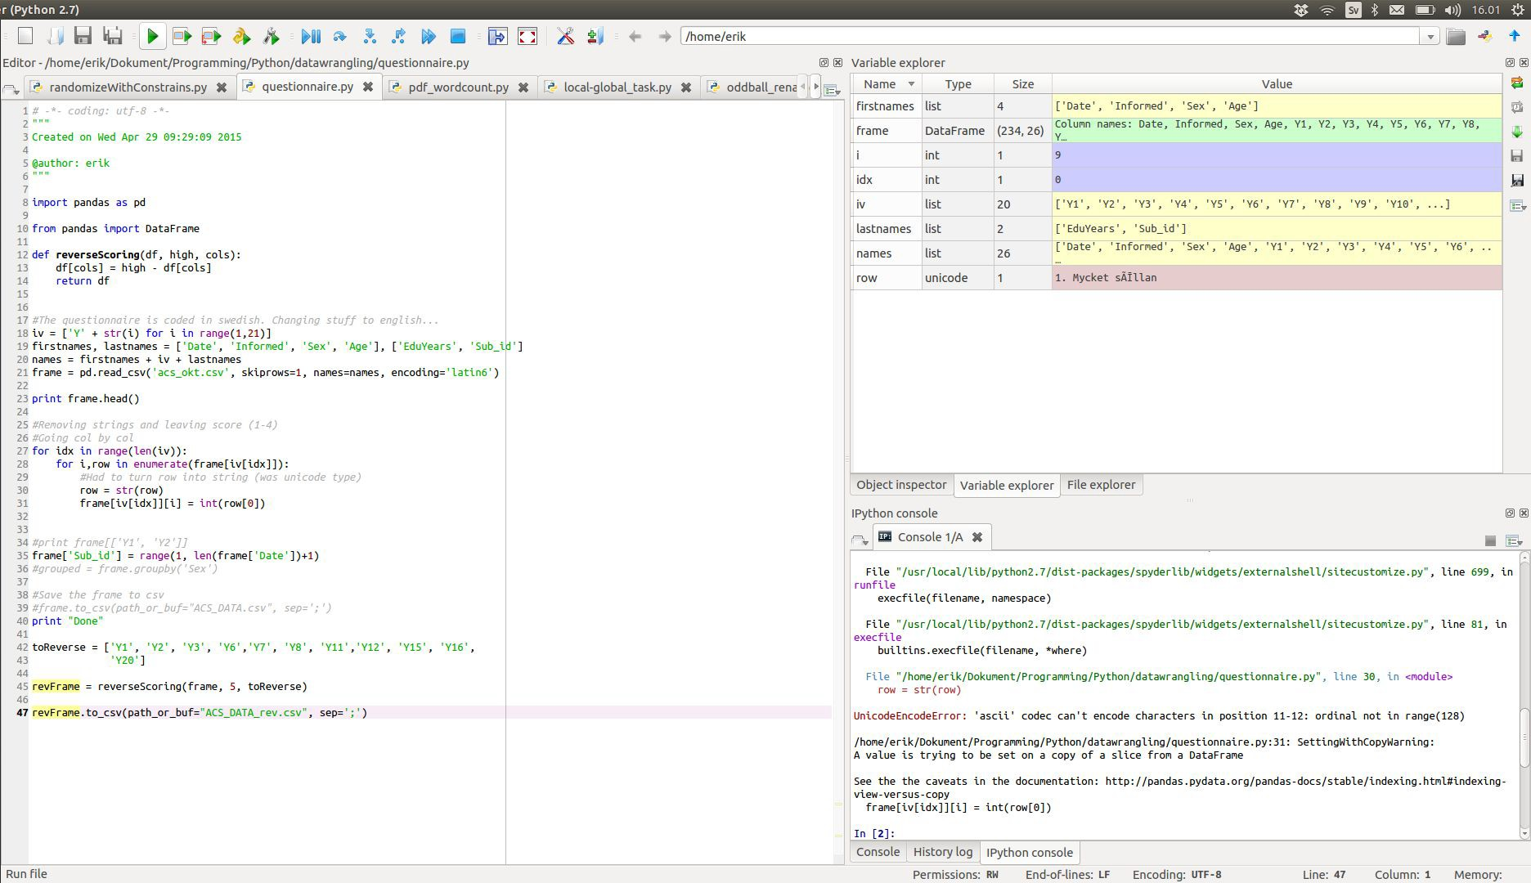
SPYDER
Spyder lets you create a script (left) and run the script (bottom- right) in the same window.
You can also see the variables you’ve created
(top-right)

Slide 35
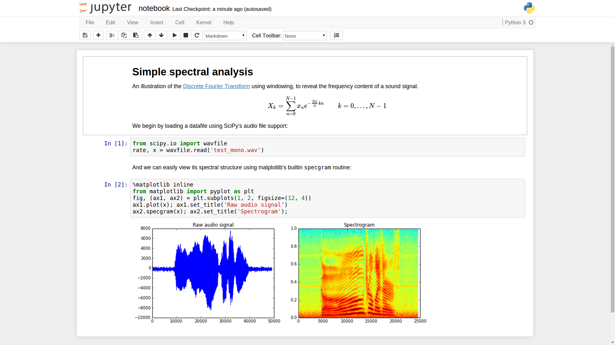
JUPYTER NOTEBOOKS
Jupyter lets you create a notebook (similar to a document) that has code segments and the results from the code segments right below.
These documents can be shared easily and edited by the audience to get new results
Notes:
Jupyter is an environment for working with code, also referred to as an “interactive development environment” or IDE.
Like most IDE’s, your specific options, versions, and configurations may vary based on user preference.

Slide 36
JUPYTER NOTEBOOK
But wait, what’s a notebook?
Jupyter is an open-source console designed for interactive computing, allowing you to work in notebooks* that can import dozens of programming languages and libraries.
A notebook is a file where you can write code, create graphs or images, and take notes... all in one place!
You can work with Jupyter notebooks locally or deploy them on a remote server to expand your processing power, collaborate, and share your work with others!
Notes:
* Deep dive: Jupyter is technically a console that runs iPython notebooks, which is a distinct kernel environment.
In practice, these two tools have merged; while notebook files are still technically labeled .ipynb (e.g. ipython notebook), it is fine to describe them as “Jupyter” notebooks.
If you want to read more about how these two tools converged, go here: https://ipython.org

Slide 37
DATA ANALYSIS WITH PYTHON
WORKING WITH
DATA IN PYTHON

Slide 38
PYTHON DATA TYPES
Integers
Whole numbers from negative infinity to infinity, such as 1, 0, -5, etc.
Floats
Short for floating-point number: Any rational number, usually used with decimals such as 2.8 or 3.14159.
Strings
A set of letters, numbers, or other characters. ("Get excited for data science")
Notes:
Instructor note: Have students practice writing and creating these data types in a BQuant or Jupyter Notebook (or Python terminal).

Slide 39
CODING IN PYTHON
Case (Upper and lower) matter in Python
If you say: a=2
Asking for “a” will return 2
Asking for “A” will give you nothing unless you’ve assigned a value to it
Each new line is a new command
If you want Python to display “hello” and then display “goodbye”, you have have to say:
print(“hello”)
print(“goodbye”)
Cannot say: print(“hello”) print(“goodbye”)
You can use a semicolon to indicate a new line

Slide 40
CODING IN PYTHON
Indentation matters in Python
Typically used after a colon
Used similar to how curly brackets {} are used in other languages
Cannot indent a line unless needed for the code
Spacing (mostly) doesn’t matter in Python
On the same line, you can have as many spaces as you want
All three lines will run the same
print( 2+2)
print( 2 + 2)
print( 2 + 2)

Slide 41
IMPORTING DATA INTO PYTHON
Now that we know what our different data types look like, let’s load some data into our environment for analysis! Data can be loaded into Jupyter Notebook from multiple sources:
Local computer
CSV, JSON, Excel, HTML, etc.
SQL database
You can connect directly to a SQL server and query a set using python.
Notes:
Instructor note: Have students practice importing a sample file using the Pandas code on the next slide.

Slide 42
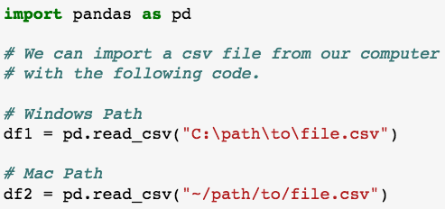
IMPORTING DATA INTO PYTHON
Next, let’s use Pandas to import a local CSV file.
Notes:
Instructor note: Have students practice importing a CSV file into a DataFrame.
Prompt: What is one of the primary reasons we might use Pandas to analyze our data?
Answer: Many reasons, but one is because Pandas makes it easier for us to create and manipulate dataframes!

Slide 43
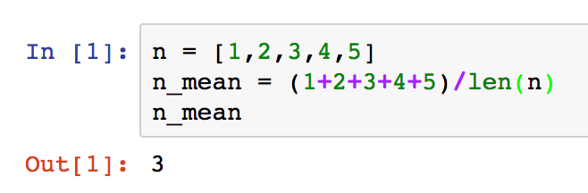
FUNDAMENTAL CONCEPTS OF PYTHON
Using Python, we can easily calculate mathematical functions.
In this example, we’re going to calculate the mean of the following list (n) using Python. What do you think len stands for?
Notes:
Len: Returns the number of items in an object. In this case, the object n is predefined as a set of five integers, and n_mean is defined as the sum of those integers divided by the total number of items in the object n. In other words, it’s the same basic math we would use to calculate an average.
Instructor Note: Instructors should run the same code above on their own computer to demonstrate a sample Python script. Ask the class to follow along in BQuant/Jupyter if possible. This will make it easier for them to jump into the next activity.

Slide 44
DATA ANALYSIS WITH PYTHON
INTRODUCTION TO DATA ANALYSIS WITH NUMPY

Slide 45
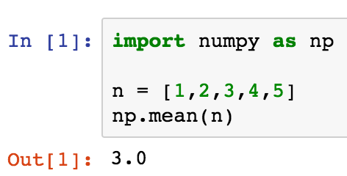
NUMPY ARRAYS
NumPy is a common Python library that works by storing data in an array.
An array is a collection of related data items, called elements, associated with a single variable name.
Arrays are useful! They can simplify programming and code performance.
Notes:
Sidenote: All elements in an array have to be of the same type.

Slide 46
NUMPY
NumPy has built-in functions to calculate descriptive and inferential statistics.
E.g. mean, median, mode, range, variance, standard deviation, etc
For example, using NumPy, we can calculate the mean with a built-in function:
Notes:
Prompt: In the example shown, which element is the array?
Answer: The array shown here is “n = [1,2,3,4,5].”
The variable, n, stores data in an array; the data being stored are the integers one through five, as well as the order in which they appear.

Slide 47
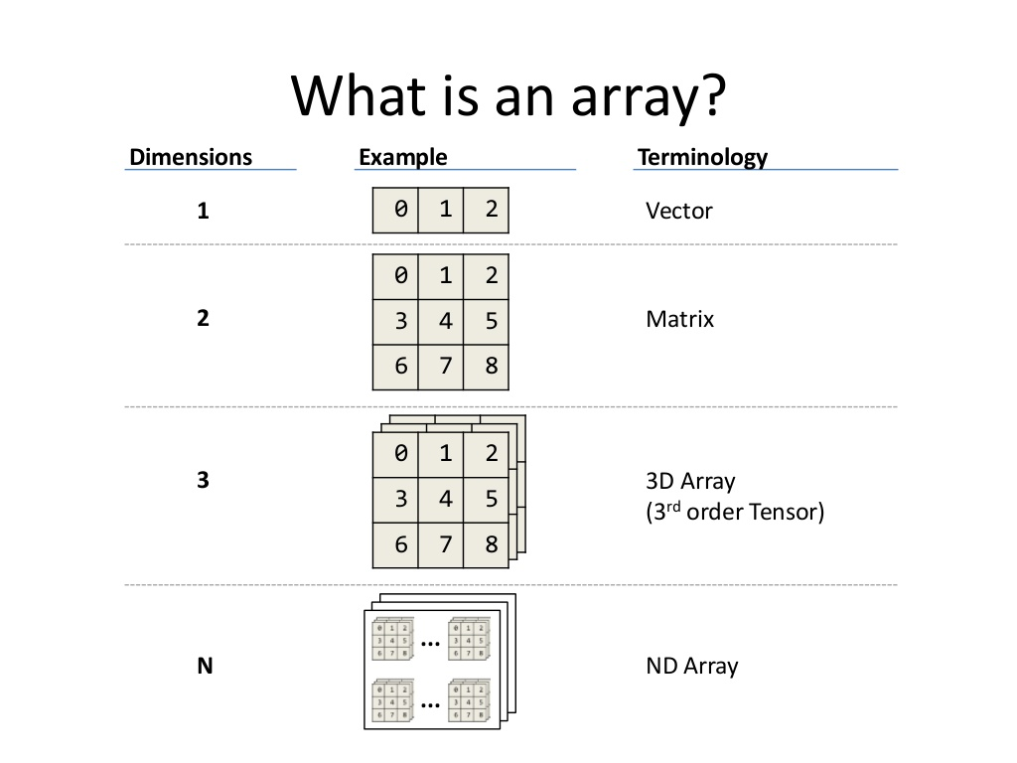
NUMPY ARRAYS
A vector is a one-dimensional array.
A table, or matrix, is a two-dimensional array.
A three-dimensional array is called a tensor.
Notes:
Tip: A “tensor” is a three-dimensional array that’s commonly used for storing the types of information used in machine learning (which explains the title of Google’s popular machine learning Python library, TensorFlow).
Tensors are a good representation of one way that computers store programming data.

Slide 48
NUMPY ARRAYS
To create an array, we can enter the following into our notebook:
import numpy as np a = np.array([1, 2, 3, 4, 5]) b = np.array([5, 4, 3, 2, 1])
np.add(a, b)
Output:
[6, 6, 6, 6, 6]
Notes:
Instructor note: Prompt the class to follow along with this in Jupyter/Bquant.

Slide 49
DATA ANALYSIS WITH PYTHON
GUIDED PRACTICE:
INTRO TO PANDAS

Slide 50

ACTIVITY: PYTHON AND PANDAS EXCERCISES
DIRECTIONS
EXERCISE
- Go to:
github.com/whsky/intro_to_python_bootcamp
- Click on the “Intro to Python Bootcamp.ipynb” file
- Click on the “Raw” button at the top right of the file
- Save the file to your computer
make sure that you save it as “all files” not as “txt”
make sure you remove the “.txt” from the filename
(you may want to use Chrome)
Notes:
Questions to ask if time permits:
Why is subsetting data important or useful?
What are other things in the data set on which we could have subset?
What might be useful to graph out of this information?
Walk through the data types that we have in this particular data set (i.e., dates, numeric, categorical). What are the levels of the categorical data?
What types of similarities do we see between this demonstration and ideas we learned in Excel and SQL?

Slide 51
DATA ANALYSIS WITH PYTHON
GUIDED PRACTICE: ANALYZING A DATA SET USING PYTHON PANDAS

Slide 52
PULLING IT ALL TOGETHER
Start with SQL
Pull in any specific data you need using SQL.
Open a notebook
Import data and any Python libraries into a Jupyter notebook.
Perform some hypothesis testing
Calculate the p value to test for statistical significance in Python.
Alternatively, you could create a linear model in Excel!
Graph and output your data
Graph outputs of your analysis using Pandas or another plotting library.
Alternatively, you could export your data set to Tableau!

Slide 53
DATA ANALYSIS WITH PYTHON
CONCLUSION

Slide 54
CONCLUSION
Python is a versatile programming language that’s capable of enabling data analysis, machine learning, website building, and much more.
Python has a ton of open-source tools and libraries that make data analysis easier — including Pandas, Jupyter, NumPy, and more.*
Python is versatile and can be used in conjunction with other tools, such as Excel, SQL, or Tableau.
Notes:
* Python also features many cutting edge libraries for machine learning and big data processing, like Scikit-learn, Tensorflow, Keras, and more!
To learn more, try out our part time or immersive data science course offerings.

Slide 55
WHAT DID WE LEARN?
In this lesson, we:
Defined the basics of introductory Python syntax.
Demonstrated how to represent data in Python.
Discussed some advantages/disadvantages of using Python.
Mapped out possible approaches to data analysis using Python libraries.
Demonstrated how to use platforms like Jupyter Notebook when running Python code.

Slide 56

FEEDBACK
Please take 2 minutes and share your feedback
www.ga.co/introclass
Thank you!

Slide 57
DATA ANALYSIS WITH PYTHON
Q&A

Slide 58
DATA ANALYSIS WITH PYTHON
RESOURCES

Slide 59
RESOURCES
DATA ANALYSIS WITH PYTHON
Pandas Tutorials
NumPy Tutorials
Ggplot Tutorials
Interactive Python Tutorial
Interactive Graphs Using Python
Great Python Libraries
Hypothesis Testing
Installing a Jupyter Notebook
Keep an Eye Out for More General Assembly Workshops or Bootcamps

Slide 60
CITATIONS
DATA ANALYSIS WITH PYTHON
Diamonds data set from ggplot2’s “R” package: http://docs.ggplot2.org/0.9.3.1/diamonds.html
Pandas uses: https://pypi.python.org/pypi/pandas/
NumPy array image: http://www.java67.com/2014/08/what-is-array-data-structure-in-java.html
Tableau Hyper: https://www.tableau.com/about/blog/2017/10/announcing-hyper-tableau-105-beta-77026

Slide 61

Thank You! Interested in upcoming classes and events? Visit: ga.co/denver

